Slide 1

Framework - Part 3
Track Value & Changes in Value and Explain Why they Occur

Slide 2
Potential Investment - FS
$50,000 minimum investment
Additions can be made monthly
Redemptions can be obtained monthly
There is a long track record…

Slide 3
FS Annual Track Record (Actual)
Year | Percentage Return
1 | 18.58%
2 | 14.67%
3 | 11.68%
4 | 11.49%
5 | 12.95%
6 | 12.99%
7 | 14.00%
8 | 13.40%
9 | 14.18%
10 | 11.55%
11 | 10.68%
12 | 9.33%

Slide 4
FS Performance

Slide 6
More Information
As of the date at which the performance information ends, FS had $5.1 billion in assets.
FS is part of a firm that had $8.3 billion in assets.

Slide 7
Want to Invest?
Clearly, a lot of people did.

Slide 8
Even More Information
FS is actually the Fairfield Sentry Fund
Time period was from the end of 1990 to the middle of 2004
Their investment strategy?
They simply invested all their money in another hedge fund named BLMIS ran by this man…

Slide 9
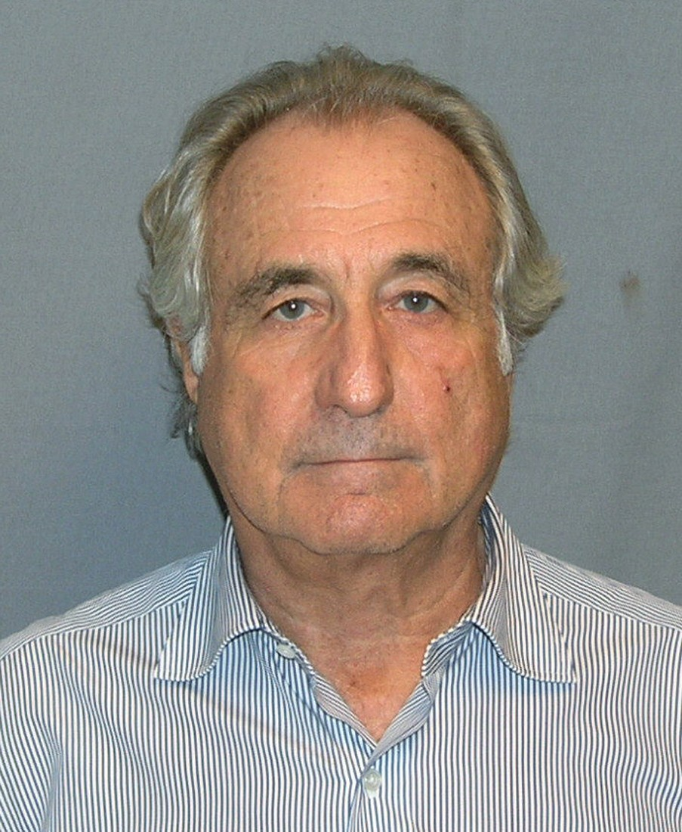
Bernard L. Madoff

Slide 10

Federal Correctional Complex, Butner (FCC Butner) North Carolina
Bernie Madoff should die in prison, US government says
By Jordan Valinsky, CNN Business
Updated 9:48 AM ET, Thu March 5, 2020
New York (CNN Business) - Bernard Madoff should not be released early from his 150-year prison sentence, even though he has terminal kidney failure, federal prosecutors said Wednesday.
The 81-year-old Madoff, who orchestrated the largest Ponzi scheme in history, asked for compassionate release from prison last month, saying he has less than 18 months to live.
https://www.cnn.com/2020/03/05/business/bernie-madoff-release/index.html
150 years in federal prison and $170 billion in restitution

Slide 11
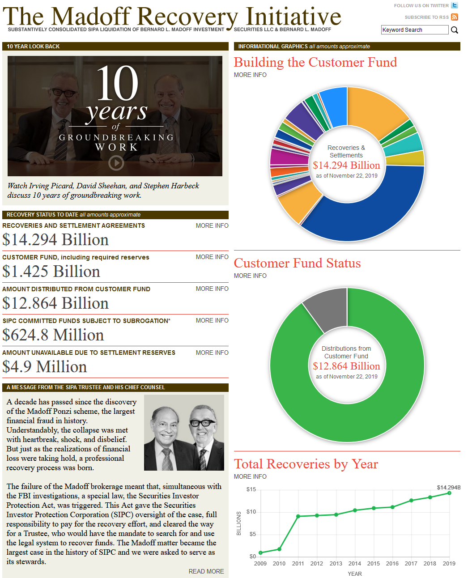
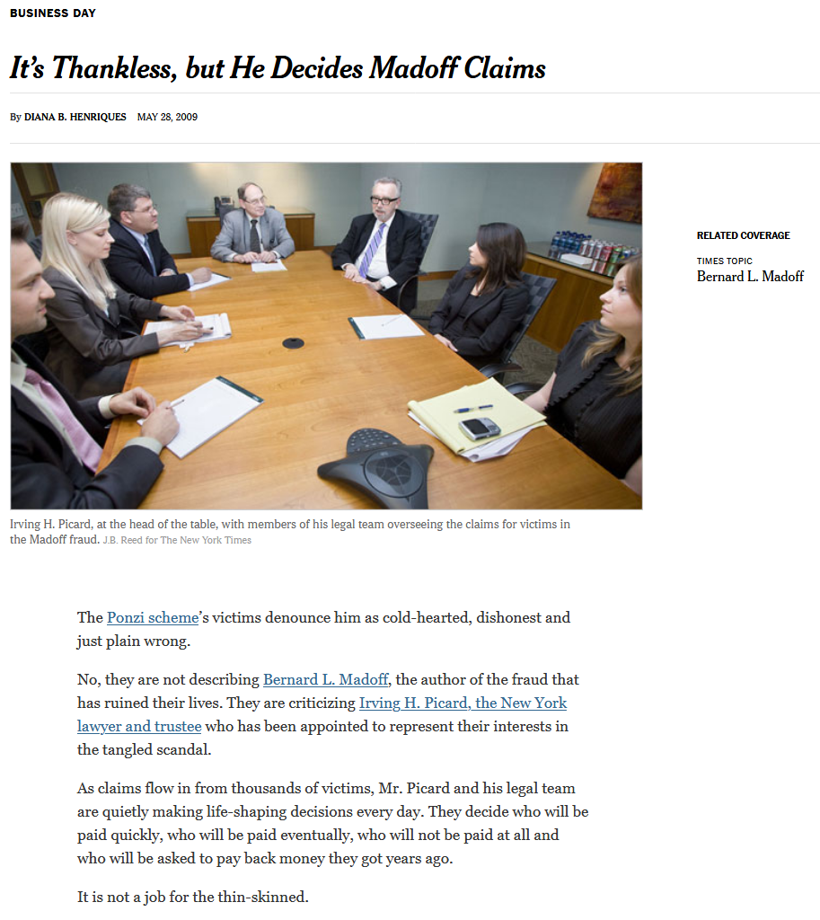
Cleaning Up the Mess
https://www.madofftrustee.com/
https://www.nytimes.com/2009/05/29/business/29claims.html

Slide 12
Ponzi Schemes
Work by inviting/encouraging/inducing people to make a key mistake:
Confuse creation of wealth for society with the redistribution of wealth among the members of society.
In accounting words: confusing income (or profit) generating activities with financing, or capital raising (and returning) activities.
An entity creates value for an economy when the value of the goods and services it supplies exceeds the value of the goods and services it consumes in generating that supply. It destroys value when the value of the goods and services it consumes in production exceeds the value of the goods and services it produces.

Slide 13
Extent of Damage Caused by Failure to Assess Value and Value Creation
The pyramid scheme phenomenon in Albania is important because its scale relative
to the size of the economy was unprecedented, and because the political and social
consequences of the pyramid schemes were profound.
Jarvis, C., “The Rise and Fall of the Pyramid Schemes in Albania”, IMF Staff Papers Vol. 47, No 1., p. 1.
"In the wake of a nationwide catastrophic collapse of savings that led to losses totaling
about 40% of the Albanian gross domestic product, the authors detected apparent
long-term deleterious health effects of financial loss and downward intergenerational
subjective social mobility."
Burazeri, G., A. Goda, G. Sulo, J. Stefa, and J. D. Kark, "Financial loss in pyramid savings schemes, downward social mobility and acute coronary syndrome in transitional Albania," Journal of Epidemiology and Community Health (1979-), Vol. 62, No. 7 (July 2008) pp. 620-626.
YOUTUBE links you might find interesting – no warranty or endorsement should be inferred!
https://www.youtube.com/watch?v=NuO6dNjNMtU
https://www.youtube.com/watch?v=lMUtU0tOmNE

Slide 14
How Important is Accounting? Kushim
If Kushim was indeed a person, he may be the first individual in history whose name is known to us! … It is telling that the first recorded name in history belongs to an accountant, rather than a prophet, a poet or a great conqueror. Harari, Y., Sapiens: A Brief History of Humankind, p. 123.

